Slide 1
Week 47
Group one
Steering Meeting

Slide 2
Week 47 time tracking in hours
Team member | Week 47 | Total time
André | 20 | 48
Anton | 17 | 58
Amer | 26 | 64
Džana | 16 | 58
Jawid | 20 | 58
Kevin O. | 23 | 54
Robert | 20:13 | 57:34
Noah | 22 | 50

Slide 3
Previous Week
_Project planning_ | _Implementation_ | _Design_
1 task | 11 tasks | 6 tasks
21 hrs | 92 hrs | 19 hrs

Slide 4
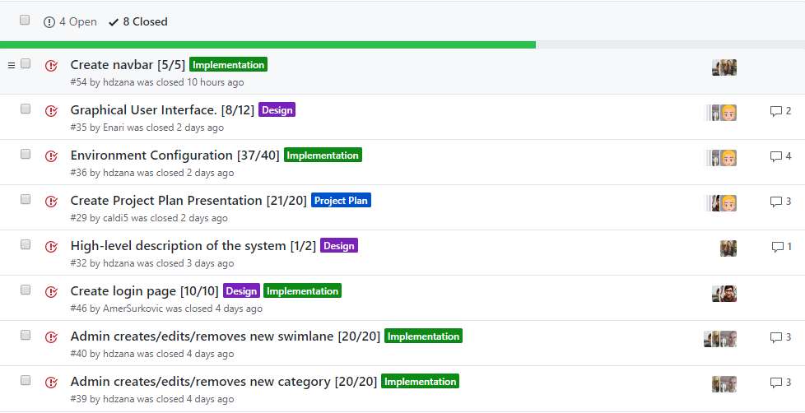
Previous Week (½)
Notes:
Created navbar
Paper design by everybody
Everybody configured their workspace
Project plan presentation

Slide 5
Previous Week
Notes:
High level description for the design document
Admin functionality for edit and remove swimlanes
the same but for categories

Slide 6
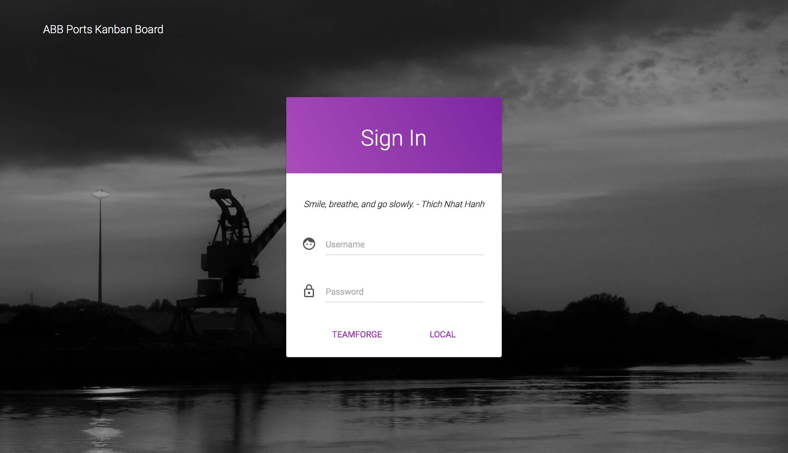

Slide 7

Obstacle and Issues
Still...

Slide 8
This Week
_Implementation_ | _Design_
11 | 6

Slide 9
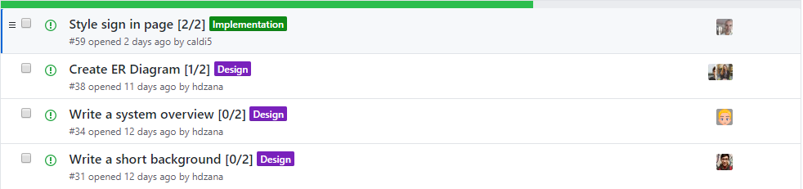
This Week (⅓)

Slide 10
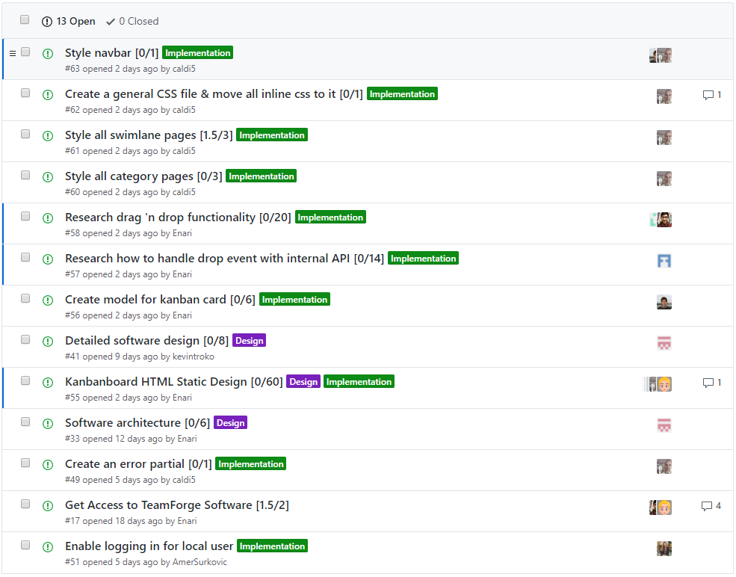
This Week (⅔)

Slide 11
This Week

Slide 12
Questions?

